Slide 1
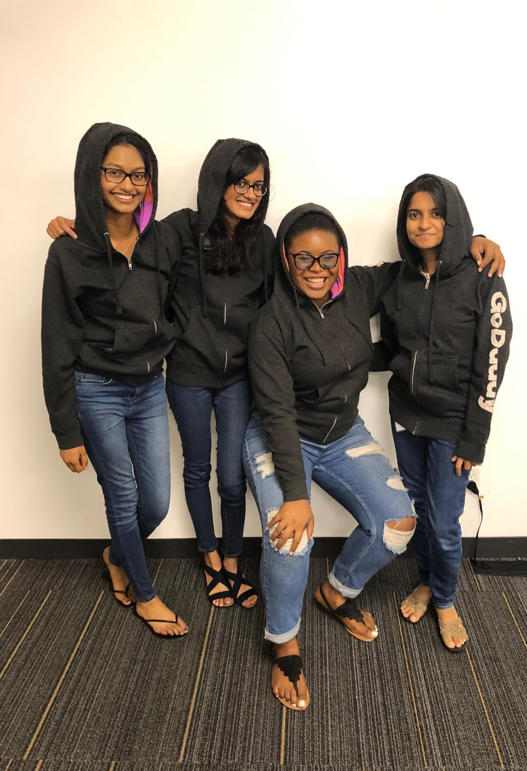

Team GoLady
Notes:
Hi everyone. our team is golady. i am shivaani. that is victoria. Namthia and anyusha

Slide 2

Our Proactive Care Agents
Notes:
Talk about how the care center is labor intensive and taking notes is hard in limited time
I would like to introduce everyone to the care center guides. These guides work to deliver the best of GoDaddy to our customers and are a vital part of the company. However, they have a labor intensive job that only offers small breaks between calls. In this small time frame, it is hard to take great notes about the call.

Slide 3
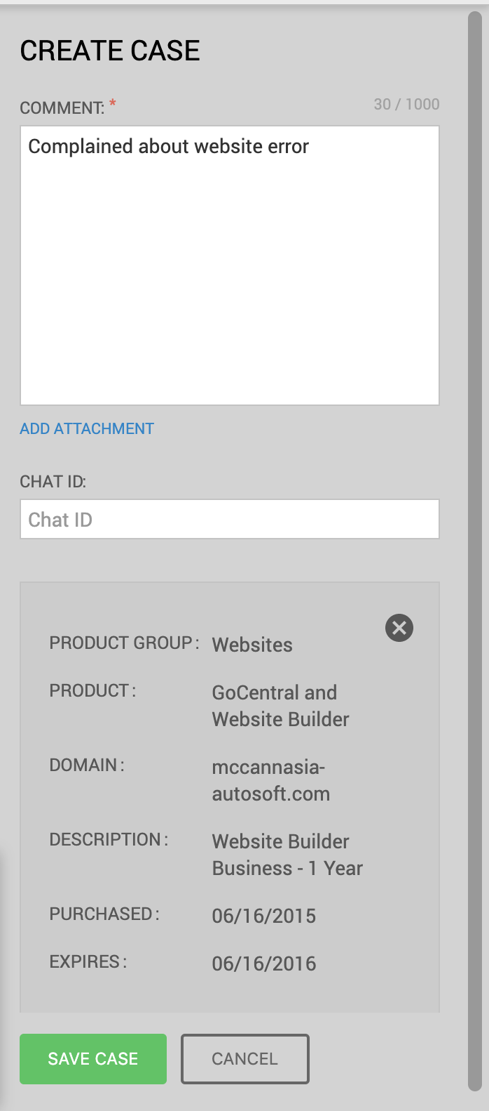
Bad Guide note
The problem, solution, or the new products suggested are not mentioned.
Notes:
Here is an example of such instance where a call summary was not accurately captured. This is a problem because the next guide that speaks with this customer will not know if the previous guide had pitched a product already, or what solution was suggested since the problem might reappear. Such instances require a more detailed record. Bad note taking may occur because the time between calls was not enough or it might be because of human error and the guides miss out on details.

Slide 4
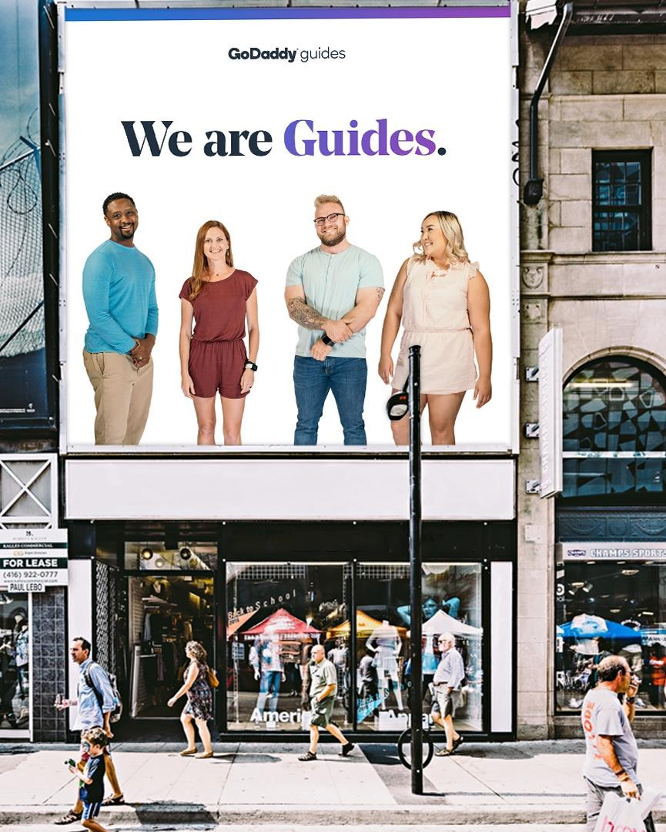
Note Enhancer
Solution
Notes:
We are offering a solution that attaches keyphrases from the call to the note created by the guide to solve this problem of bad note taking. We wanted a solution that does not rely on the guide or add additional tasks for them as we know that they have a short period of gap between calls.

Slide 5
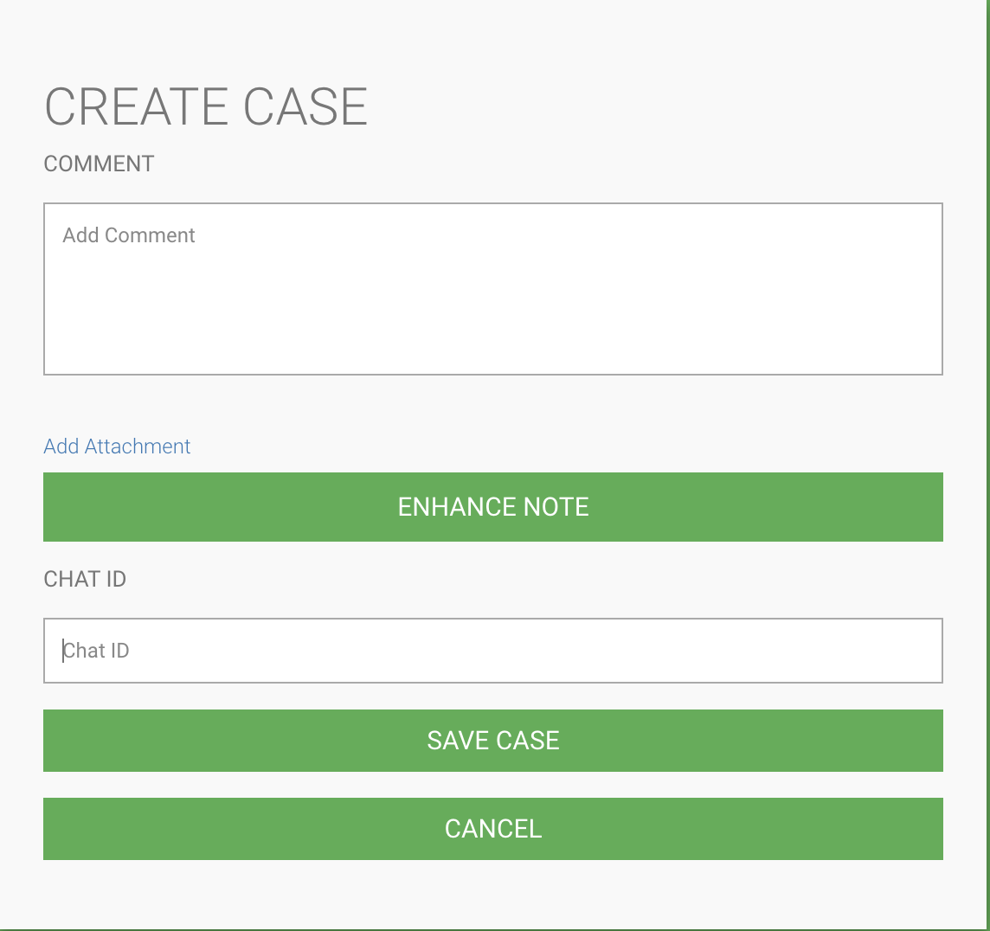
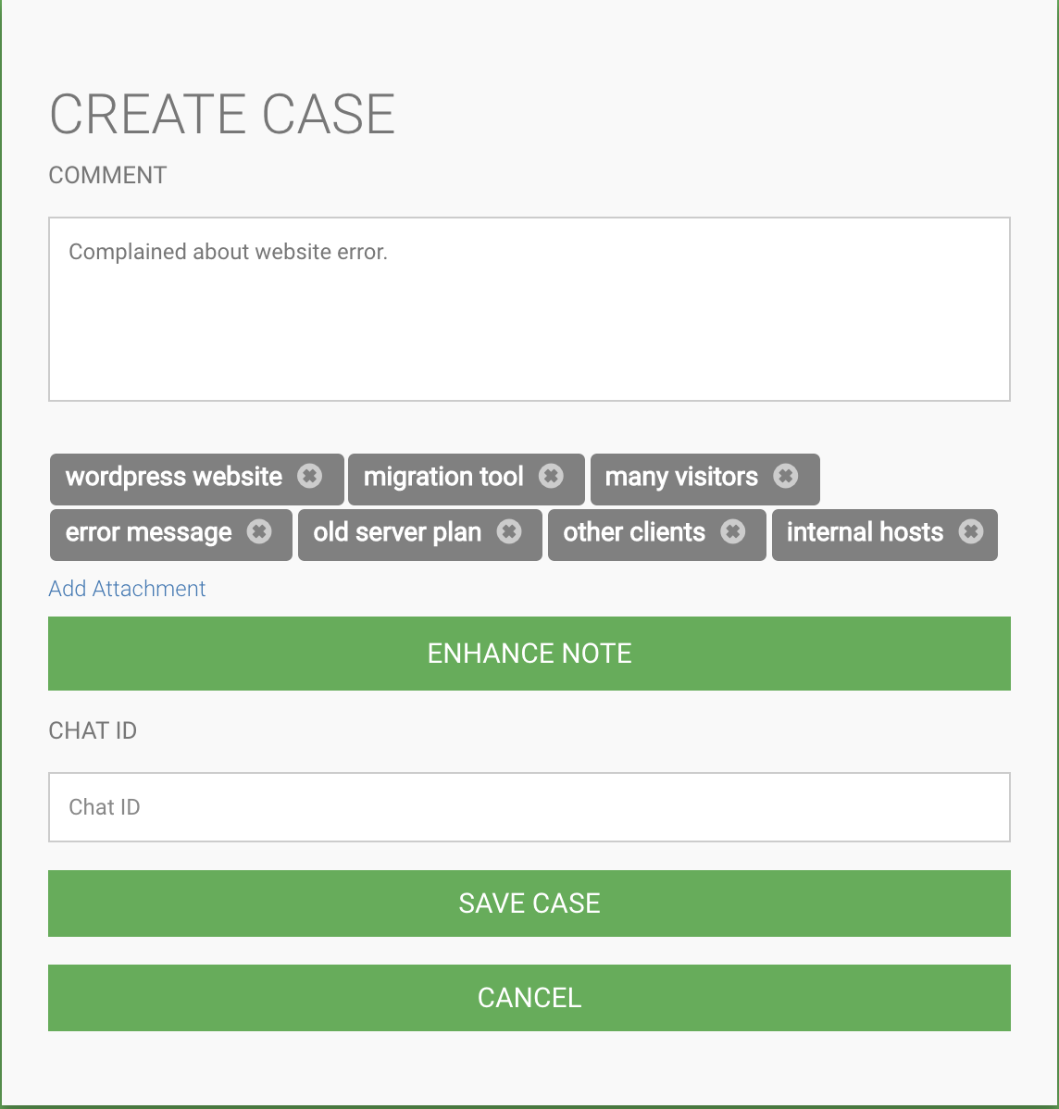
Application - Mock-up UI
Notes:
what we have shows here is a frontend mockup of how the backend keypharases extractor we have created can be implemented in the CRM

Slide 6
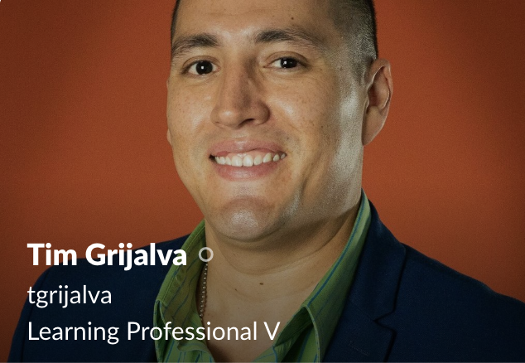
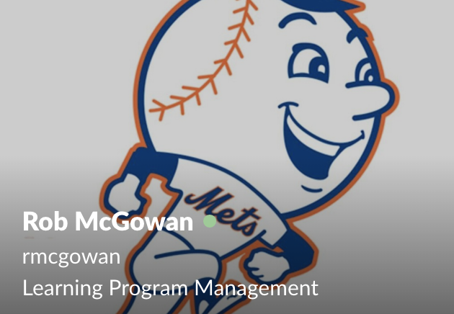
Our Guides
Sample Headline
“IB calls are recorded in our recorder.”
https://godaddy.jiveon.com/community/c3/call-library
Notes:
When starting out project, the main concern was that we may not have access to a reocirding of the guide conversation. After speaking with Tim Grijalva (who is a learning professional) we learned that inbound calls are recorded in the recorder so we do have access. we also learned from Rob that Godaddy has a call library of sample calls we could access.

Slide 7
Technologies

Slide 8
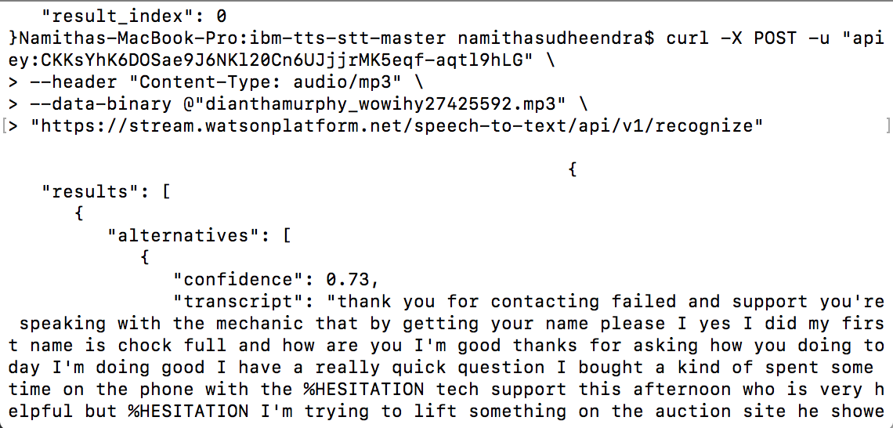
Watson API
Notes:
Taking the guides conversation with a customer as an mp3 file and converting it to text for processing

Slide 9
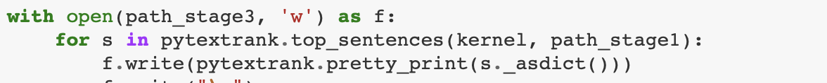
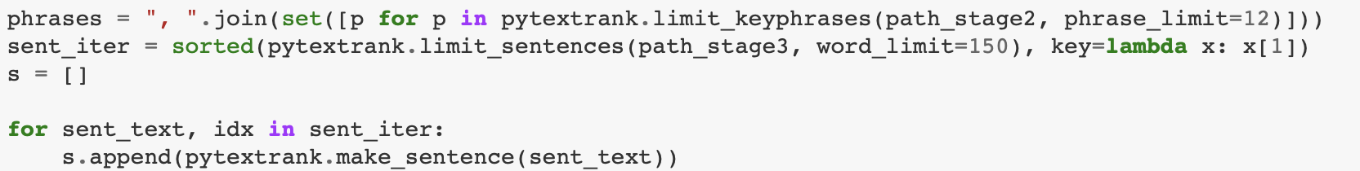
Python package pytextrank
Perform statistical parsing/tagging on a document in JSON format
Collect and normalize the key phrases from a parsed document
Calculate a significance weight for each sentence, using MinHash to approximate a Jaccard distance from key phrases determined by TextRank
Summarize a document based on most significant sentences and key phrases
Notes:
This python package extract the keyphrases from the text and creates a summary of the conversation. This graph ranking algorithm calculates the cooccurrences of sentences based on similarity and ranks them accordingly.

Slide 10
DEMO
Notes:
We want our guides to have the necessary tools to deliver a call that satisfies their customer.

Slide 11
Future Plans
Security
Accuracy
Integration
Ensure that confidential information does not get stored
Increase speech to text accuracy
Integrate our application with the CRM
The scaling of the application

